Slide 1
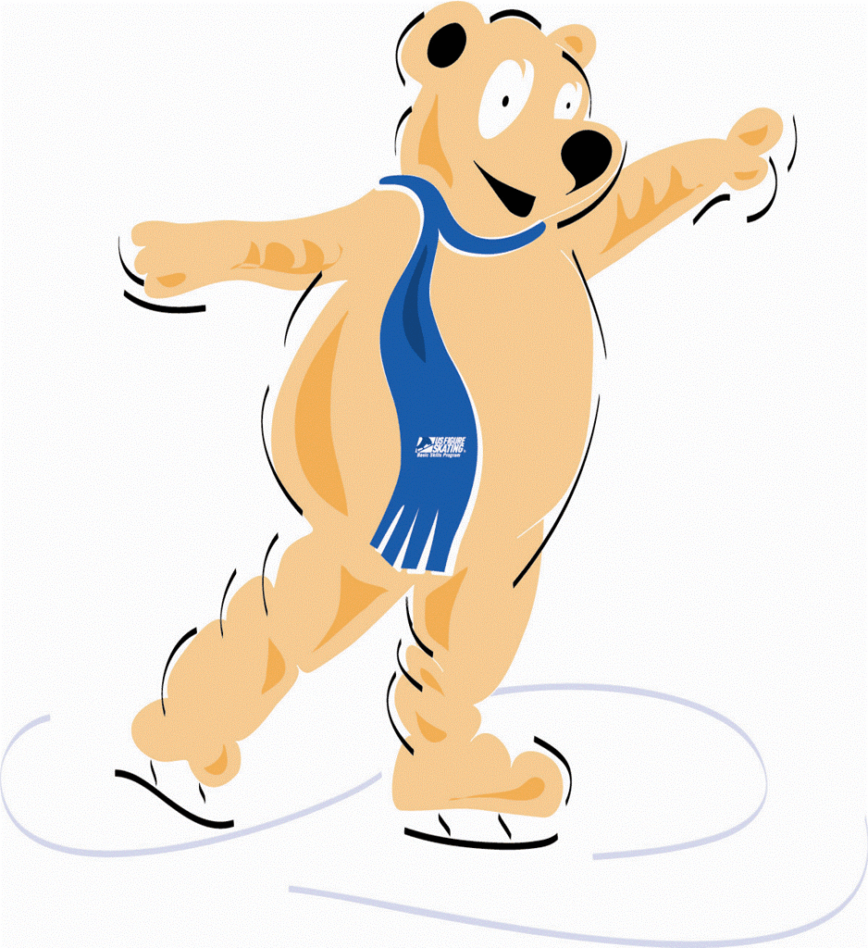
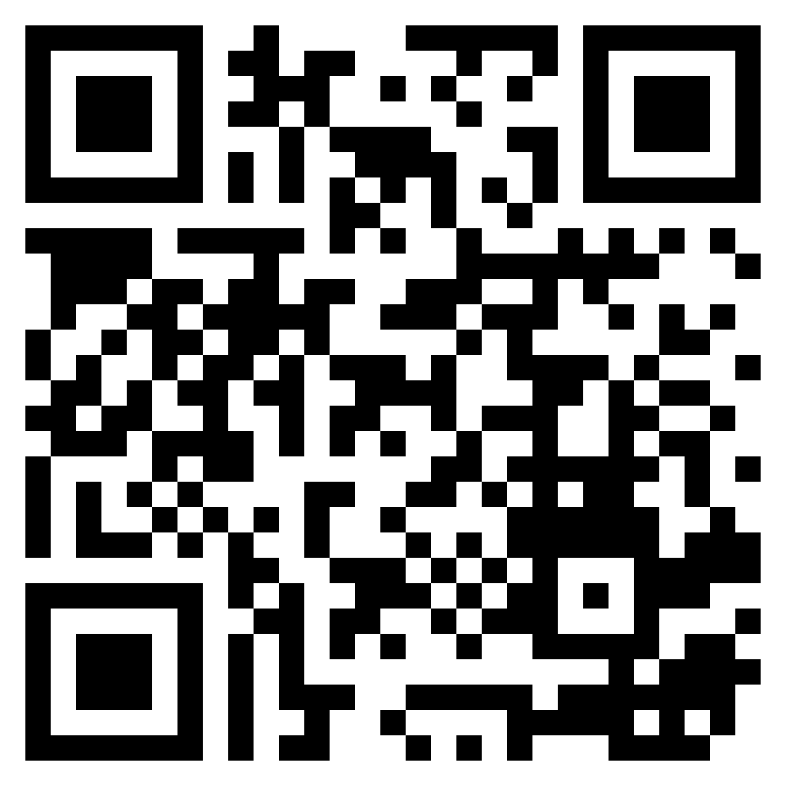
2023-2024 Learn To Skate
Looking to ice skate? Manitowoc Country Figure Skating Club offers Learn to Skate
Classes at the Manitowoc County Ice Center (MCIC) on Tuesday and Wednesday evenings.
Classes meet once a week for a half hour for skaters ages 4 – adult. Skate rental is available
for $2 per class. Upon completion of the class, skater will receive a badge for passing.
New Skaters!
Session 3: Classes start January 2 or January 3
Class Times:
Tuesday Evenings: 1/2, 1/9, 1/16, 1/23, 1/30, 2/6 | Snowplow Sam 1 (Age 4-6) Basic 1 (Age 7 and up) | 5:30 p.m. - 6:00 p.m. 6:00 p.m. - 6:30 p.m.
Wednesday Evenings: 1/3, 1/10, 1/17, 1/24, 1/31, 2/7 | Snowplow Sam 1 (Age 4-6) Basic 1 (Age 7 and up) | 5:00 p.m. – 5:30 p.m. 5:30 p.m. - 6:00 p.m.
All registration for this will be online or mail-in.
www.manitowoccountyfsc.com
Session 3:
Registration: December 19 5:30 p.m. - 6:45 p.m.
December 20 5:00 p.m. – 6:15 p.m.
Tuesday Classes: January 2 – February 6
Wednesday Classes: January 3 – February 7
Tuesday + Wednesday Classes – 6 weeks
$84 for the session
$2 for skate rental per time
6 weeks x $2 = $12 per session
2024 Ice Show:
“There’s No Place Like MCFSC”
Saturday, March 16, 2024
1:00 p.m.
4:00 p.m.
Saturday, March 17, 2024
1:00 p.m.
4:00 p.m.
Public Skate
Saturdays & Sundays
1:30 – 3:00 PM
Now through February 25
For additional information go to our website www.manitowoccountyfsc.com or call Chris Pawlowski at 920-973-6756.

